Slide 1
CB Segmentation Process Details
By Sargam Shah
03/19/2020

Slide 2
Touch Point Logic
No change in ODS process
Excel interface to write, changed picked up by the system
Trigger an update when excel interface is changed
Excel interface does the segmentation of the product
ODS -> Interim
Building a view on two tables customer dim and customer sum
Update all records everyday

Slide 3
Drools Process
View will be created: seg_basetable_view
Calculate trigger flag using Drools
Sends result back to update the view
Pull view again and do segmentation value calculation
Result into two tables: com_cus_dim , com_customer_edw

Slide 4
Design decisions
If any scenario such as handoff fails, we need to figure out the process and also to track it
Discuss the flag reset scenario

Slide 5
CB Segment dataflow logic
I guess this is clear from the Status call on Thursday, March 19.

Slide 6
Drool Setup Brief Notes
Aim: Segment the customers based on rules to market the products
Deadline: April 01, 2020
It is a Maven Project
Com.cox.dss.model contains Customer. Java which will help build the rules based on the fields
RulesSegTable.xls is as follows
Please go through Drools documentation or tutorials on how it works

Slide 7
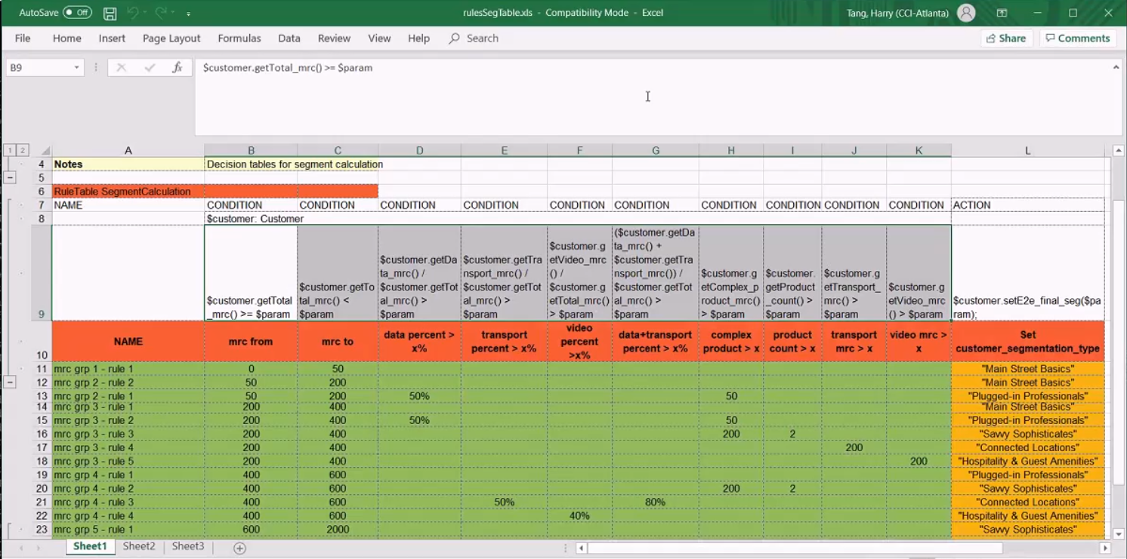

Slide 8
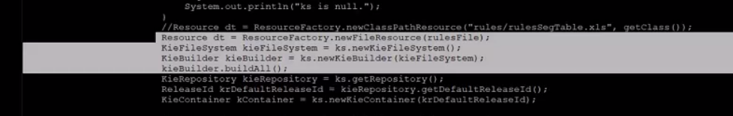
CBSegmentationProcess.java
Utilizes multithreading to read the sites and apply rules
Config file contains 1. RulesPath 2. Siteids
Run the files using: java –cp target/decisiontable1-1.0-SNAPSHOT….

Slide 9
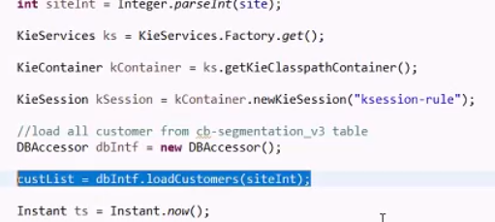
SegmentThreadExecutor.java
Property file has site ids
Invokes segmentthreadexecutor for each site
Ksession.fireAllRules()

Slide 10
Build Part
Mvn clean package
Add two lines to kie session for it to work [need to find a solution]
Kiesession is not null – should come when you compile
This is the whole process explained!
Ozzie scheduler is needed

Slide 11
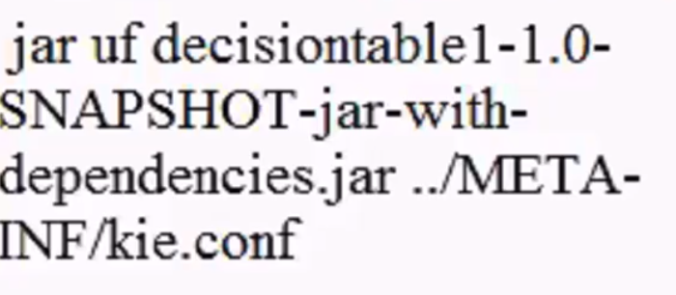
Dependencies
From informatica to Big data
Creation of base table
Wrap all of this in a shell script and invoke from Oozie
Shell command:
Work with CI/CD team to work on build and QA

Slide 12
Contacts
Harry Tang
Raghav
Ashok

